Slide 1











Proteus: Shapeshifting Desktop Visualizations for Mobile via Multi-level Intelligent Adaptation
Kavinda
Athapaththu
Can Liu
Sizhe Cheng
Feng Liang
Zhibang Jiang
Lingru Huang
Yong Wang
Can Liu¹, Sizhe Cheng¹, Feng Liang¹, Zhibang Jiang¹,
Lingru Huang², Kavinda Athapaththu¹, Yong Wang¹

Slide 2
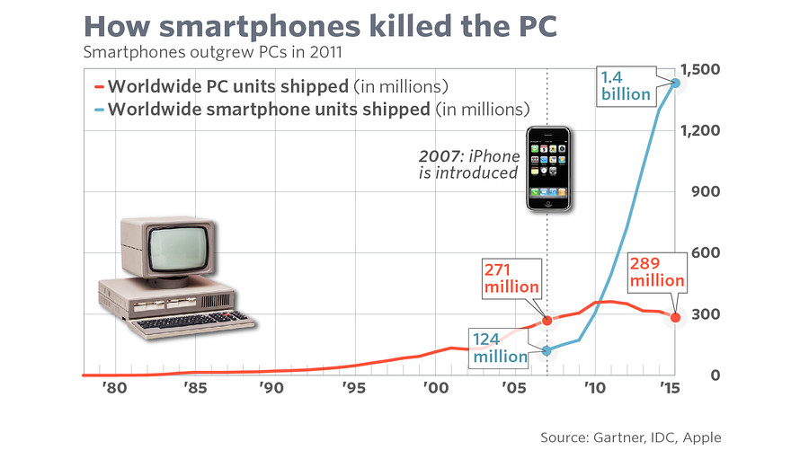
Desktop-first Visualizations, Mobile-first World
Background
Design Space
Multi-Agent System
Evaluation
97 steps. one question.
Can you find the one wrong step?
Smartphones now dominate personal computing.
    (Over 1 billion smartphones are sold every year)

Slide 3
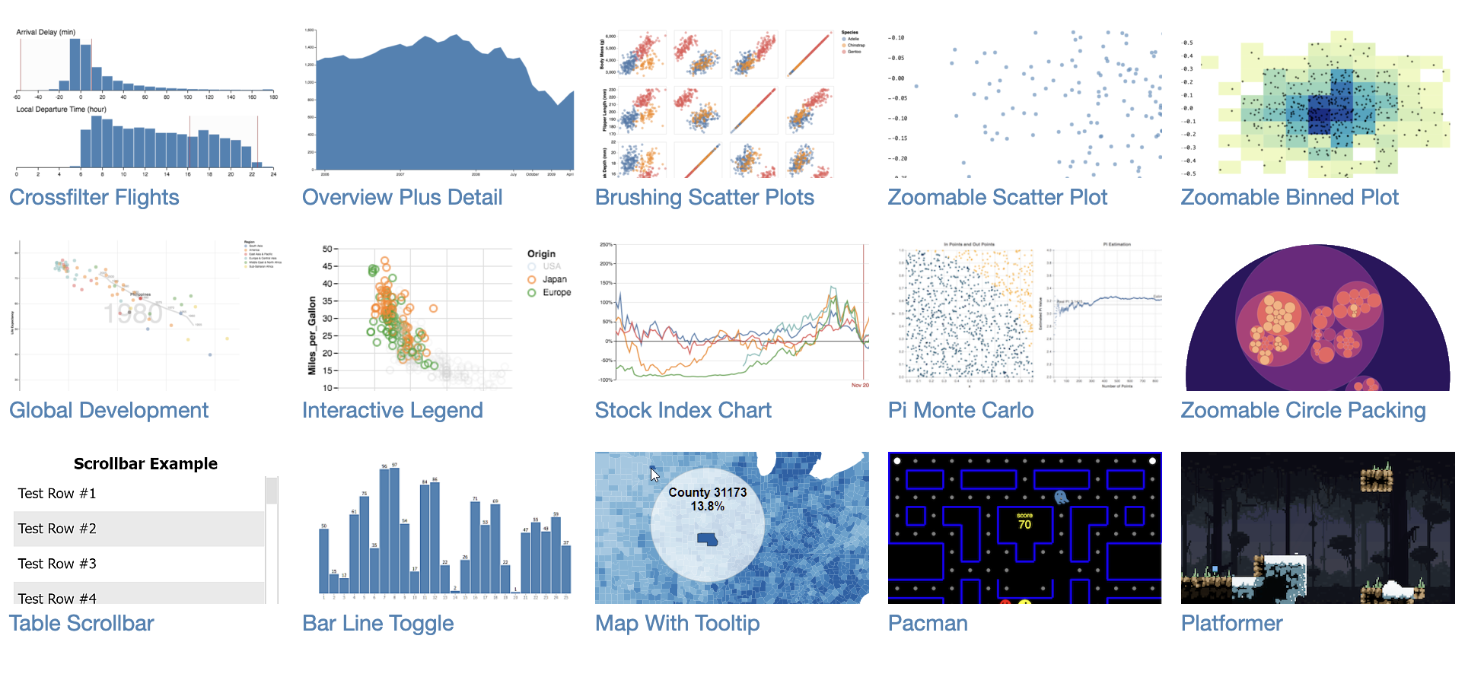
Desktop-first Visualizations, Mobile-first World
Background
Design Space
Multi-Agent System
Evaluation
97 steps. one question.
Can you find the one wrong step?
Vega Gallery (https://vega.github.io/vega/examples/)
Smartphones now dominate personal computing.
    (Over 1 billion smartphones are sold every year)
Most visualizations are designed for desktop screens.
Adapting desktop visualizations to mobile devices can expand accessibility and impact!

Slide 4
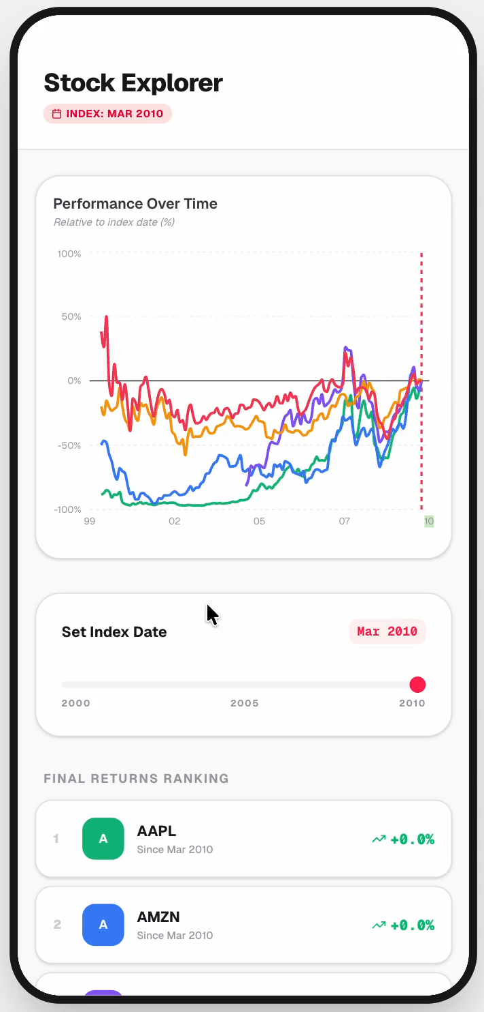
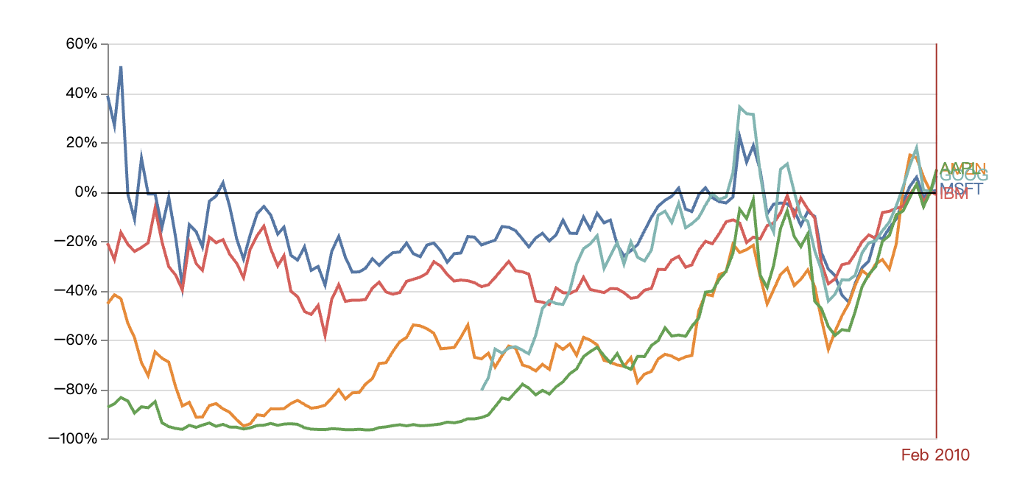
Proteus: Automatically Adapting Desktop Vis to Mobile Vis
Background
Design Space
Multi-Agent System
Evaluation

Slide 5
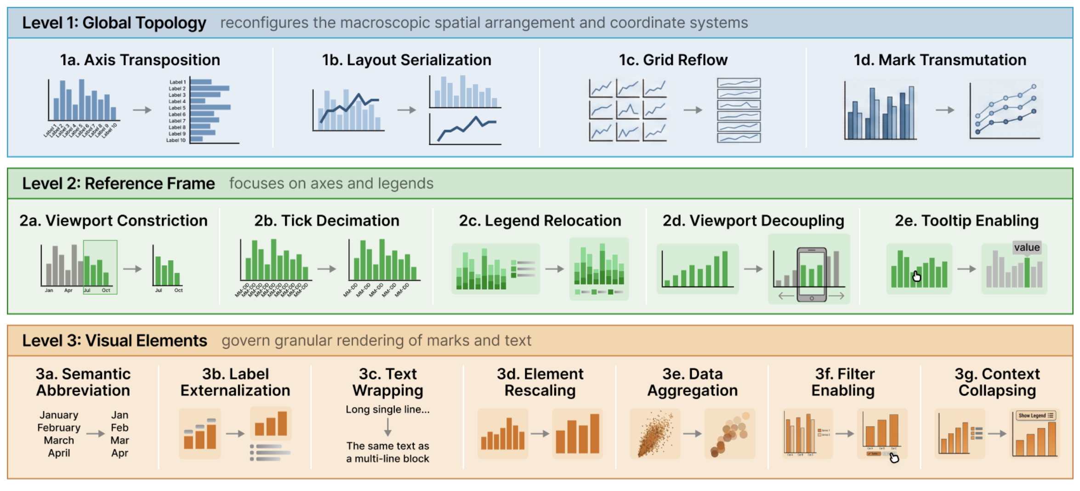
Effective Mobile Adaptation Demands Semantic Re-authoring
Background
Design Space
Multi-Agent System
Evaluation
We introduce a design space to model desktop-to-mobile transform.

Slide 6
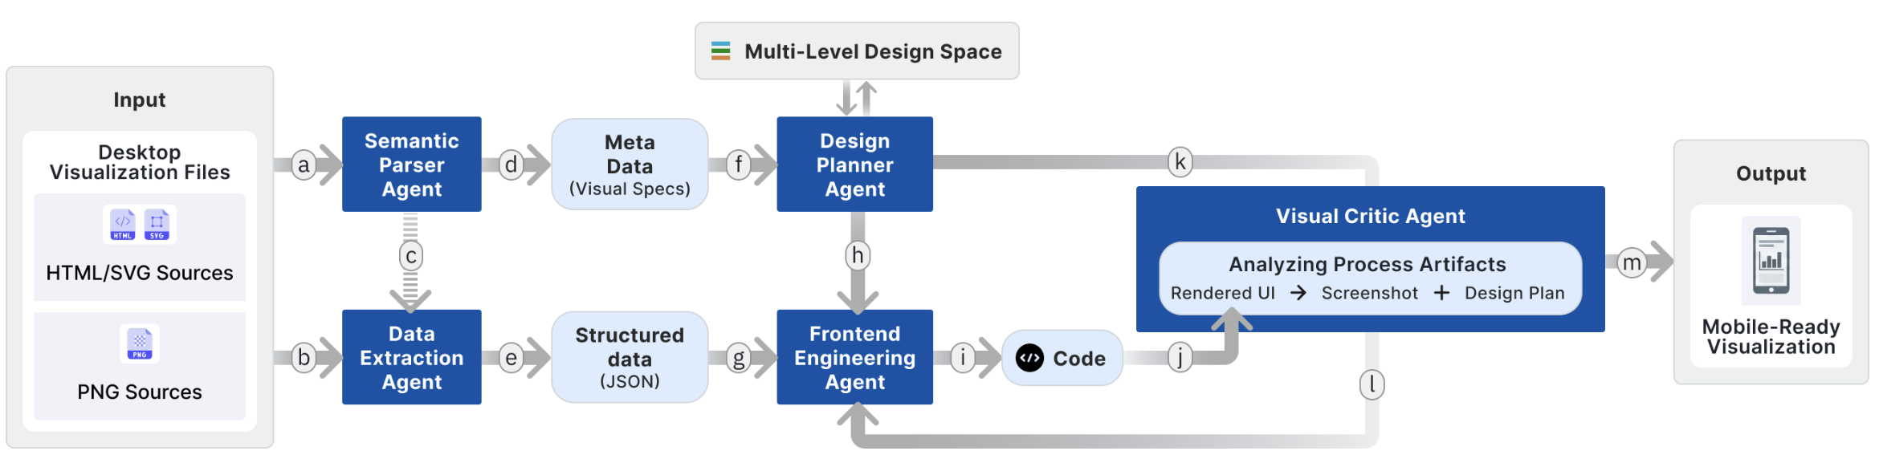
Effective Mobile Adaptation Demands Semantic Re-authoring
Background
Design Space
Multi-Agent System
Evaluation
We introduce a design space to model desktop-to-mobile transform
It is an LLM-driven multi-agent framework

Slide 7
Effective Mobile Adaptation Demands Semantic Re-authoring
Background
Design Space
Multi-Agent System
Evaluation
We introduce a design space to model desktop-to-mobile transform
It is an LLM-driven multi-agent framework
It transforms desktop charts into mobile-optimized versions

Slide 8
Effective Mobile Adaptation Demands Semantic Re-authoring
Background
Design Space
Multi-Agent System
Evaluation
We introduce a design space to model desktop-to-mobile transform
It is an LLM-driven multi-agent framework
It transforms desktop charts into mobile-optimized versions

Slide 9
Why Do We Need a Design Space?
Background
Design Space
Multi-Agent System
Evaluation
Flat rules fail because visualization elements are hierarchically dependent.
We need to formally model these cross-level dependencies.
A design space provides a systematic blueprint for transformations.

Slide 10
A Multi-Level Design Space for Adaptation
Background
Design Space
Multi-Agent System
Evaluation
L1 Global Topology: Reconfigures spatial layout
          (e.g., Axis Transposition).

Slide 11
A Multi-Level Design Space for Adaptation
Background
Design Space
Multi-Agent System
Evaluation
L1 Global Topology: Reconfigures spatial layout
          (e.g., Axis Transposition).
L2 Reference Frame: Balances precision and legibility
(e.g., Tick Decimation).

Slide 12
A Multi-Level Design Space for Adaptation
Background
Design Space
Multi-Agent System
Evaluation
L1 Global Topology: Reconfigures spatial layout
          (e.g., Axis Transposition).
L2 Reference Frame: Balances precision and legibility
(e.g., Tick Decimation).
L3 Visual Elements: Optimizes granular data ink
(e.g., Semantic Abbreviation).

Slide 13
Level 1: Global Topology Restructures Spatial Layout
Background
Design Space
Multi-Agent System
Evaluation
Makes macroscopic decisions defining the spatial structure.
Axis Transposition: Swaps X and Y to utilize vertical scrolling.
Grid Reflow: Converts dense 3x2 grids into vertical stacks.
Layout Serialization: Splits multi-view dashboards into separate pages.

Slide 14
Level 2: Reference Frame Balances Precision and Legibility
Background
Design Space
Multi-Agent System
Evaluation
Adjusts axes, legends, and scales to map data to pixels.
Tick Decimation: Reduces labels while relying on user interpolation.
Viewport Constriction: Zooms to preserve fidelity.
Interaction Injection: Adds tooltips and scrolling.

Slide 15
Level 3: Visual Elements Optimizes Atomic Data Ink
Background
Design Space
Multi-Agent System
Evaluation
Performs micro-level refinements on individual marks and text.
Semantic Abbreviation: Shortens strings without losing meaning (e.g., USA).
Label Externalization: Moves crowded in-situ labels to external lists.
Element Rescaling: Enlarges geometries for fat-finger touch targets.

Slide 16
Why Do We Need a Multi-Agent Architecture?
Background
Design Space
Multi-Agent System
Evaluation
Semantic re-authoring is too complex for a single prompt.
It requires multimodal parsing, data extraction, design planning, and coding.
Agents act like a team of experts, delegating tasks and reviewing code.

Slide 17
Proteus Uses a Collaborative Multi-Agent Architecture
Background
Design Space
Multi-Agent System
Evaluation
Simulates the workflow of a human visualization expert.
Specialized agents coordinate to generate executable code.

Slide 18
Proteus Uses a Collaborative Multi-Agent Architecture
Background
Design Space
Multi-Agent System
Evaluation

Slide 19
Proteus Uses a Collaborative Multi-Agent Architecture
Background
Design Space
Multi-Agent System
Evaluation
Step 1: Semantic Parser & Extractor deconstruct visual and extract data.

Slide 20
Proteus Uses a Collaborative Multi-Agent Architecture
Background
Design Space
Multi-Agent System
Evaluation
Step 1: Semantic Parser & Extractor deconstruct visual and extract data.
Step 2: Design Planner generates a transformation strategy.

Slide 21
Proteus Uses a Collaborative Multi-Agent Architecture
Background
Design Space
Multi-Agent System
Evaluation
Step 1: Semantic Parser & Extractor deconstruct visual and extract data.
Step 2: Design Planner generates a transformation strategy.
Step 3: Frontend Engineer implements the Next.js/Tailwind component.

Slide 22
Proteus Uses a Collaborative Multi-Agent Architecture
Background
Design Space
Multi-Agent System
Evaluation
Step 1: Semantic Parser & Extractor deconstruct visual and extract data.
Step 2: Design Planner generates a transformation strategy.
Step 3: Frontend Engineer implements the Next.js/Tailwind component.
Step 4: Visual Critic evaluates rendering and routes feedback.

Slide 23
Proteus Uses a Collaborative Multi-Agent Architecture
Background
Design Space
Multi-Agent System
Evaluation
Step 1: Semantic Parser & Extractor deconstruct visual and extract data.
Step 2: Design Planner generates a transformation strategy.
Step 3: Frontend Engineer implements the Next.js/Tailwind component.
Step 4: Visual Critic evaluates rendering and routes feedback.

Slide 24
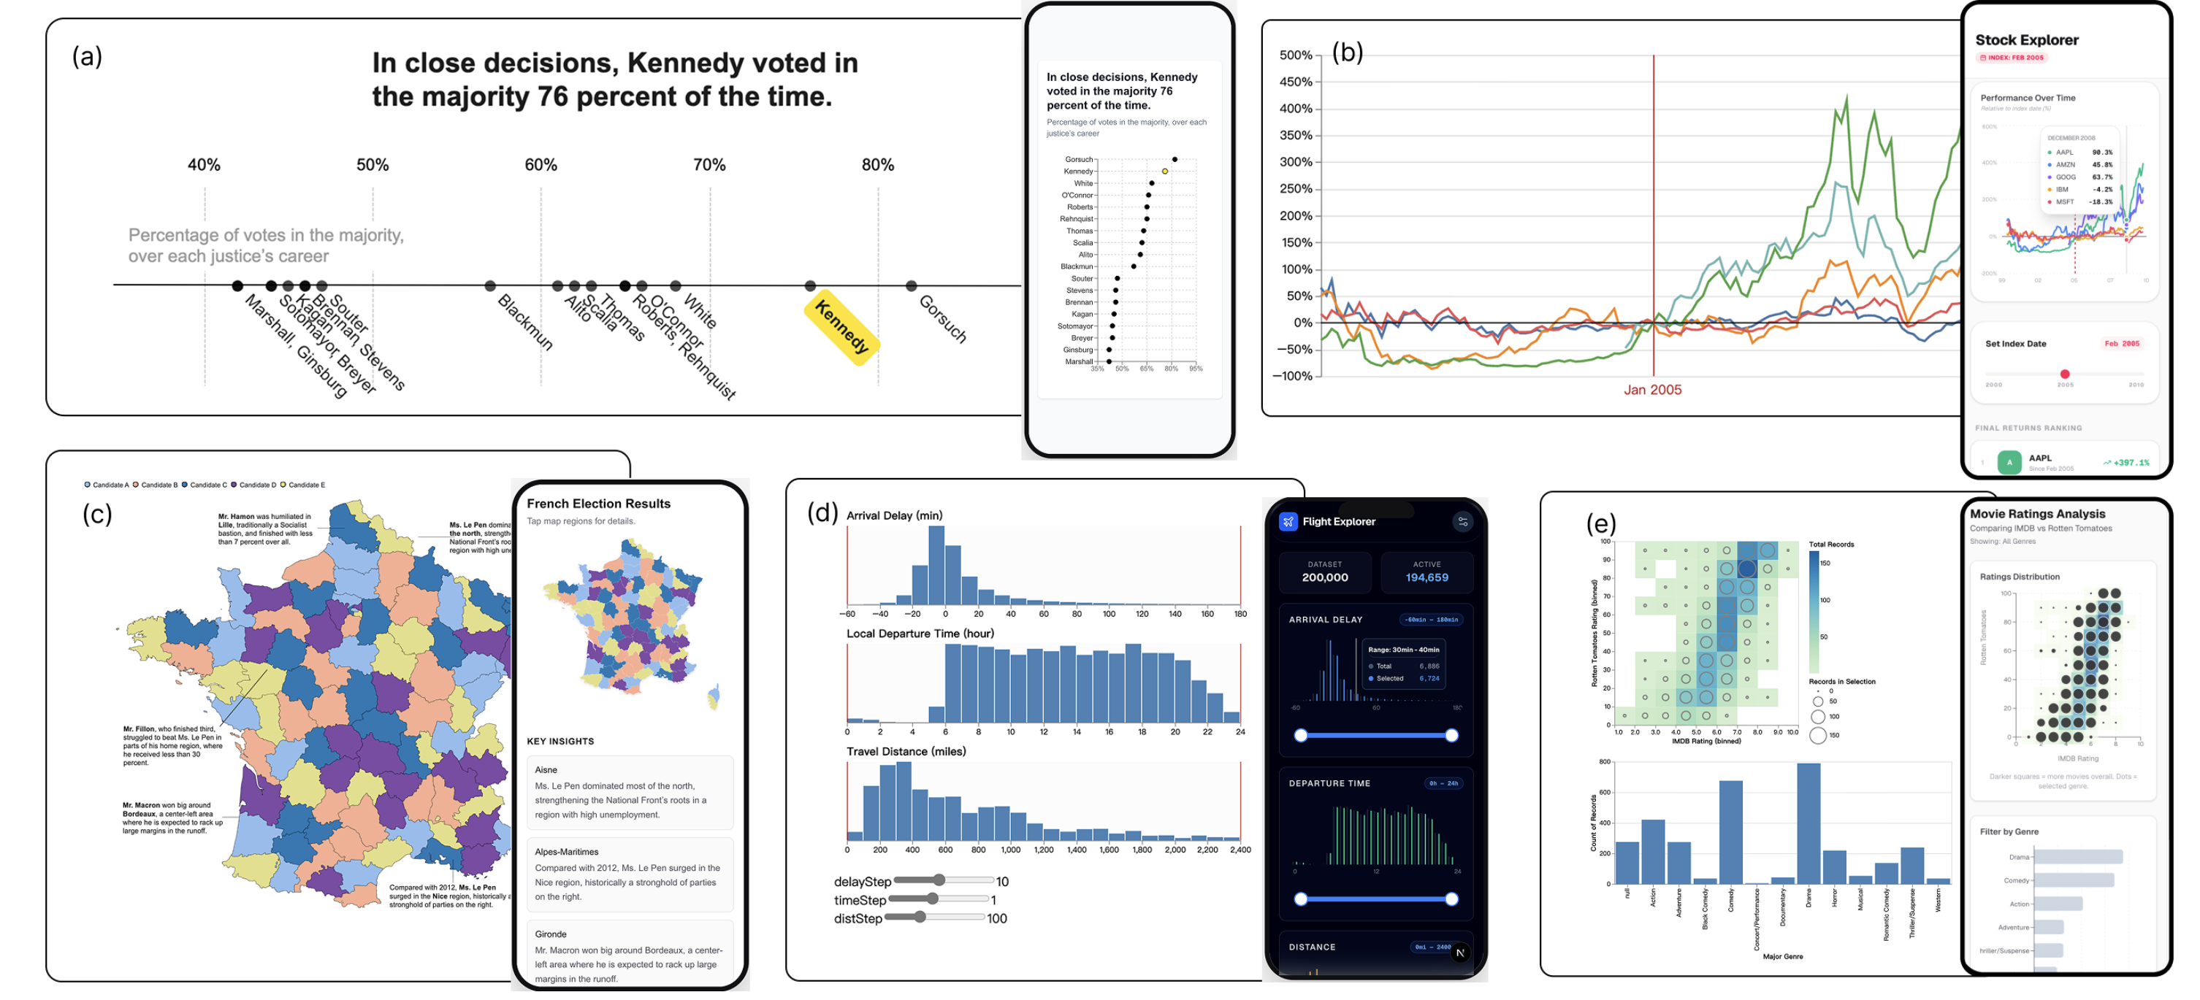
Proteus Redesigns Meaningful Mobile Interactions
Background
Design Space
Multi-Agent System
Evaluation

Slide 25
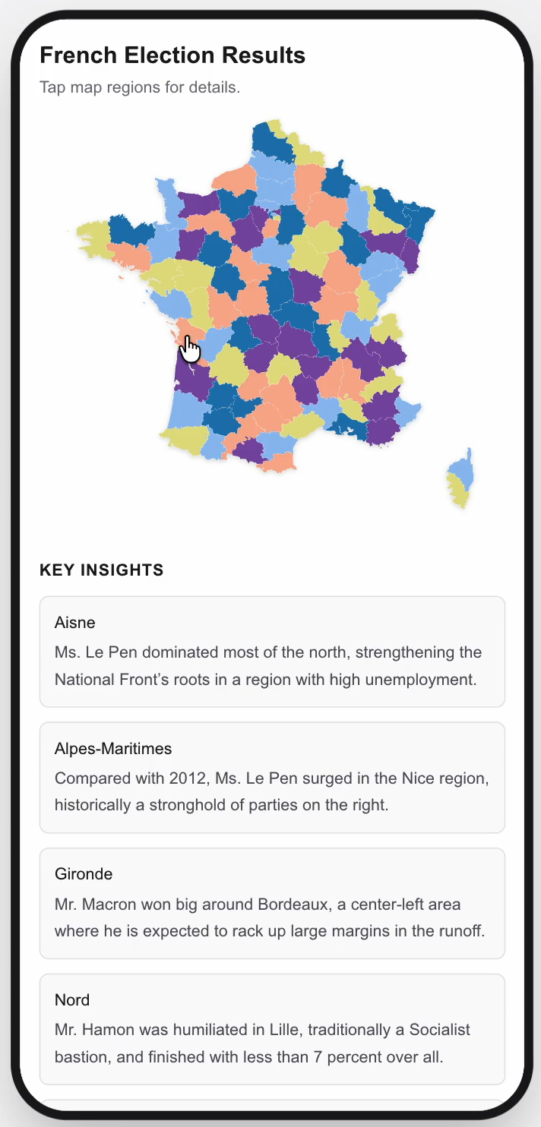
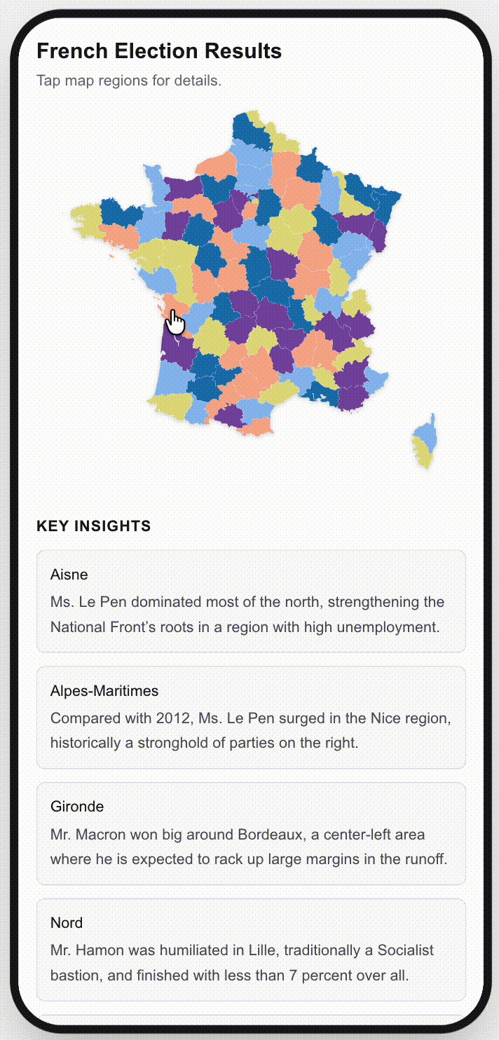
Proteus Redesigns Meaningful Mobile Interactions
Background
Design Space
Multi-Agent System
Evaluation
Externalizes desktop hover interactions to mobile sliders.
Converts dense legends into interactive filter chips.

Slide 26
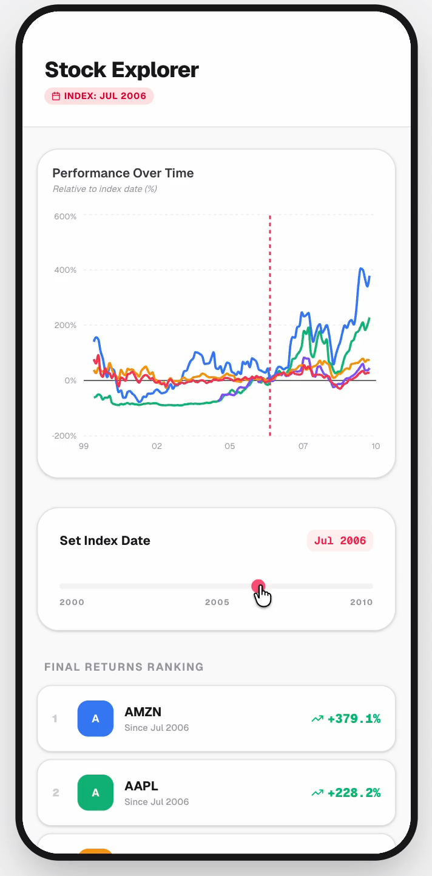
Proteus Redesigns Meaningful Mobile Interactions
Background
Design Space
Multi-Agent System
Evaluation
Externalizes desktop hover interactions to mobile sliders.

Slide 27
Compare Against a Strong LLM baseline
Background
Design Space
Multi-Agent System
Evaluation
Ours: Multi-agent system with Proposed Design Space

Slide 28
Compare Against a Strong LLM baseline
Background
Design Space
Multi-Agent System
Evaluation
Baseline: Multi-agent system without Proposed Design Space

Slide 29
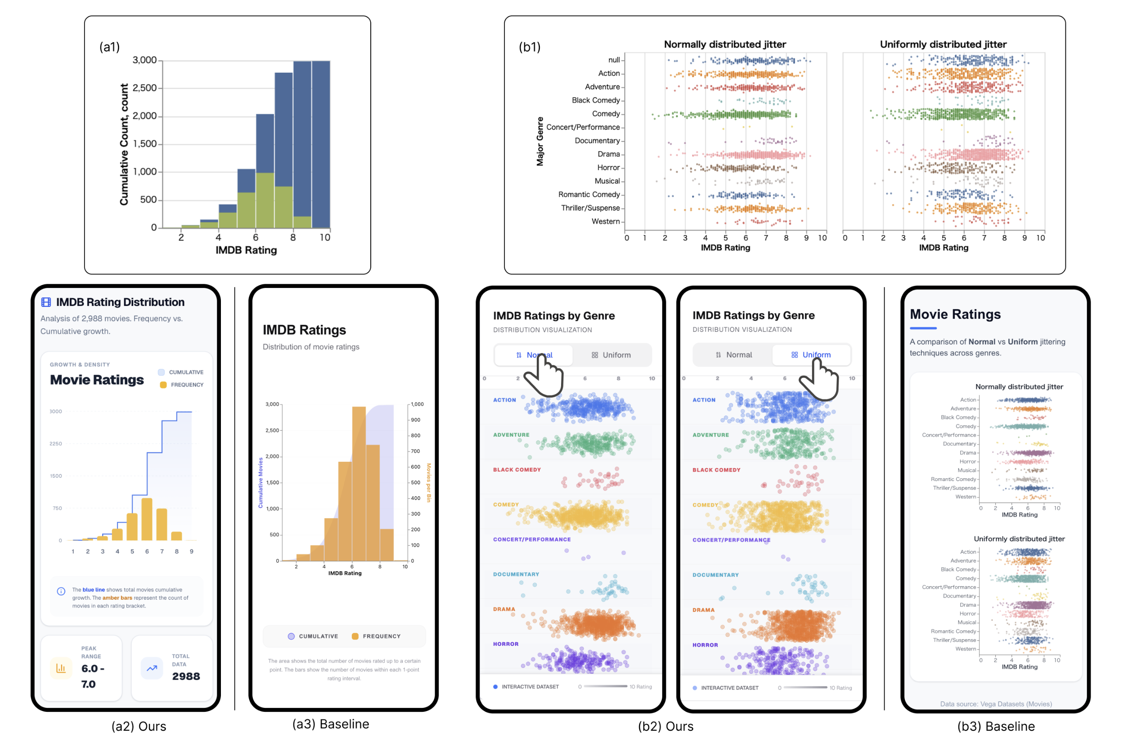
We Evaluated Proteus on 67 Real-World Visualizations
Background
Design Space
Multi-Agent System
Evaluation
Curated from D3, Vega, and Altair official galleries.
Compared against a strong multi-agent LLM baseline.
Assessed by 12 participants with visualization expertise.

Slide 30
We Evaluated Proteus on 67 Real-World Visualizations
Background
Design Space
Multi-Agent System
Evaluation
Execution Completeness, Data Fidelity, Perceptual Readability, Interaction Reasonableness, and aesthetics

Slide 31
We Evaluated Proteus on 67 Real-World Visualizations
Background
Design Space
Multi-Agent System
Evaluation
Execution Completeness, Data Fidelity, Perceptual Readability, Interaction Reasonableness, and aesthetics
Ours:
Baseline:

Slide 32
We Evaluated Proteus on 67 Real-World Visualizations
Background
Design Space
Multi-Agent System
Evaluation
Execution Completeness, Data Fidelity, Perceptual Readability, Interaction Reasonableness, and aesthetics
Ours:
Baseline:

Slide 33
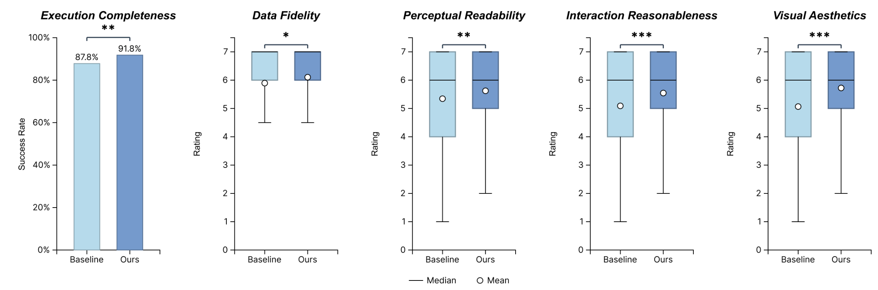
Proteus Significantly Improves Readability and Aesthetics
Background
Design Space
Multi-Agent System
Evaluation
Higher data fidelity and perceptual readability (p < 0.05).
Vastly superior interaction and aesthetics (p < 0.001).

Slide 34
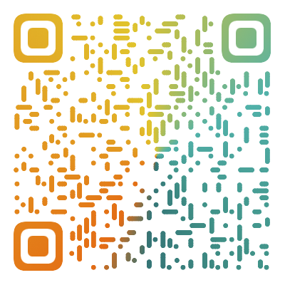


Proteus: Shapeshifting Desktop Visualizations for Mobile via Multi-level Intelligent Adaptation
Proteus Demo

